Slide 1
PHARMACEUTICAL CHATBOT USING GEN AI
NAME: Prithiv Raaj N
NM_ID: au711721243070
KGiSL Institute Of Technology
3/21/2024 Annual Review

Slide 2
PROJECT TITLE
PHARMACEUTICAL CHATBOT USING GEN AI
3/21/2024 Annual Review

Slide 3


AGENDA
•Problem Statement.
•Project Overview.
•End Users.
•Our Solution and Proposition.
•Key Features.
•Modelling Approach
•Results and Evaluation
3/21/2024 Annual Review

Slide 4
PROBLEM STATEMENT
Develop a conversational chatbot using the Hugging Face library, tailored to the pharmaceutical industry. The chatbot should handle general inquiries effectively and exhibit expertise in pharmaceutical compliances, particularly ICH9.
3/21/2024 Annual Review

Slide 5

PROJECT OVERVIEW
Develop a conversational chatbot tailored to the pharmaceutical industry.
Enable effective handling of general inquiries related to the pharmaceutical domain.
Exhibit expertise in pharmaceutical compliances, particularly ICH9 guidelines.
Assist users in understanding and complying with ICH9 standards.
Utilize natural language processing for accurate understanding and generation of responses.
Maintain a conversational tone to enhance user engagement and satisfaction.
3/21/2024 Annual Review

Slide 6

WHO ARE THE END USERS?
End users, such as pharmaceutical professionals or researchers, can use the ICH9 chatbot in several ways to enhance their understanding and application of statistical principles in clinical trials and Drug development process.
3/21/2024 Annual Review

Slide 7

YOUR SOLUTION AND ITS VALUE PROPOSITION
Our Solution :
Pharma chatbox is a conversational system designed to provide an intelligent response to the user’s queries compliances and information.
By focusing the developing LLM models, we have chosen llama-2-7b-chat.ggmlv3.q4_0.bin conversational AI model from hugging face.
The main aim of this project is to suggest the researchers and pharmaceutical industry people that safety, no side effect medicines and also avoid unnecessary clinical trials on humans and animal testing.
The model is carefully selected for its advanced understanding and has high accuracy in performance. By fine tuning the model, we can customize it to align seamlessly with ICH9 nuances and drug information database for further developing of drug.
3/21/2024 Annual Review

Slide 8

THE WOW IN YOUR SOLUTION
Pharmaceutical chatbox is a conversational system designed to provide an intelligent response to the user’s queries regarding healthcare.By focusing the developing LLM models, I have chosen llama-2-7b-chat.ggmlv3.q4_0.bin conversational AI model from hugging face. The main aim of this project is to enhance user engagement and deliver contextual relevant information. The model is carefully selected for its advanced understanding and has high accuracy in performance. By fine tuning the model, we can customize it to align seamlessly with ICH9 nuances ,ensuring precise and personalized responses.The inclusion of memory retention mechanisms like Conversational Buffer Memory , which enhances the chatbot’s ability, enabling smooth and contextually rich conversations.
3/21/2024 Annual Review
‹#›

Slide 9
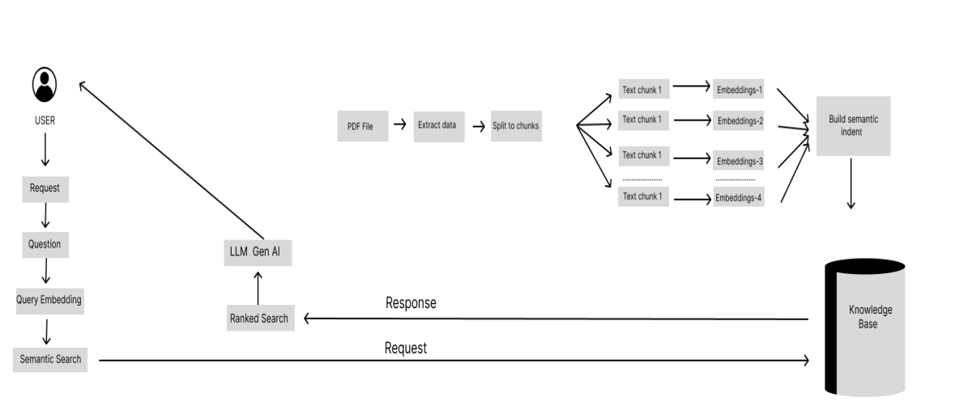
MODELLING
3/21/2024 Annual Review
‹#›

Slide 10
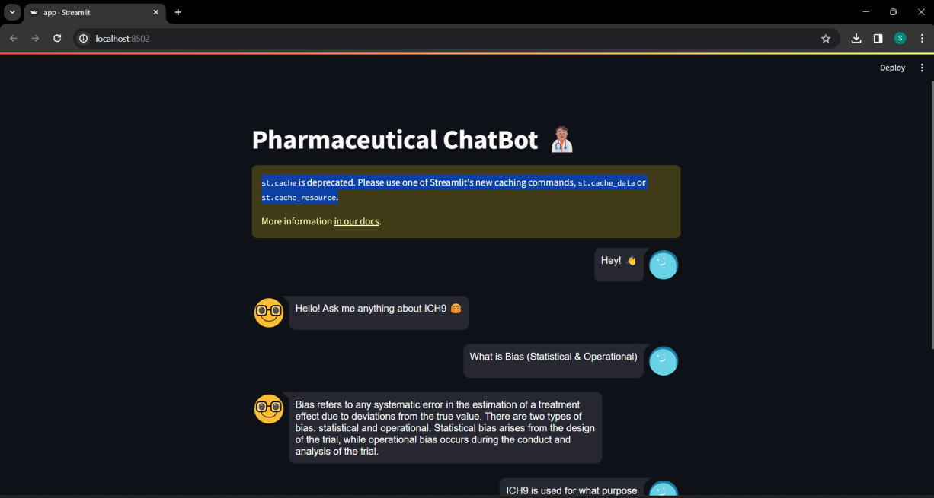
RESULTS
The project successfully demonstrates the integration of various natural language processing (NLP) components to create an interactive and responsive pharmaceutical chatbot. The use of pre-trained embeddings from Hugging Face, a vector store (FAISS) for efficient similarity searches, and a conversational retrieval chain (LLM) enhances the chatbot's ability to understand and respond to user queries. Overall, the project lays a foundation for building and extending conversational AI applications in the pharmaceutical domain, showcasing the potential of combining powerful NLP tools with user-friendly interfaces
3/21/2024 Annual Review
‹#›

